Slide 1
Fundamentals and Methods of Computer Science
Exercise week 6

Slide 2
Today’s Menu
Discussion of assignment 5 and the respective quiz
Brief summary of skills necessary to solve assignment 6
Working on assignment 6

Slide 3
Discussion of Assignment 5

Slide 4
Using a user-defined class
class definition
usage
class Person:
# Called when objects are instantiated
def __init__(self, name, year_of_birth):
self.name = name
self.year_of_birth = year_of_birth
# Object method with self-reference
def compute_age(self):
return datetime.date.today().year - self.year_of_birth
# Called when objects are printed
def __str__(self):
return f"{self.name} ({self.compute_age()})"
An object of the person class is instantiated by:
person1 = Person('Peter', 1990)
person2 = Person('Linda', 1990)
type(person1) is now custom and will be Person
person1.compute_age() is the same thing as Person.compute_age(person1). This behaviour is caused by the self reference.
F-strings (f"This is zero: {number_zero}.") have a leading f and can use variables within the {}. This is an easier way of creating strings instead of concatenation ("This is zero: " + str(number_zero) + ".")

Slide 5
Minimum and Maximum
Own implementation
Inbuilt functions
max = [None, 0]
min = [None, 0]
for i, number in enumerate(number_list):
if number < min[1]:
min[0], min[1] = i, number
if number > max[1]:
max[0], max[1] = i, number
# In the assignment we store the first person in max/min and
# iterate over all persons using the .compute_age() method.
oldest = max(persons, key=lambda p: p.compute_age())
youngest = min(persons, key=lambda p: p.compute_age())
min()/max() takes an iterable (e.g. a list) and returns the minimal/maximal value in this iterable.
By default it uses the value of the object itself, but we can specify how it determines the value with key= .
Usually your problem is not new and there exists an already written function for that (but maybe in a different library and not in base Python).

Slide 6
Inheritance
Class
Subclass
class Person:
# This method can be used from the subclass
def __init__(self, name, year_of_birth):
self.name = name
self.year_of_birth = year_of_birth
# This method can be used from the subclass
def compute_age(self):
return datetime.date.today().year - self.year_of_birth
# This method can be used from the subclass
def __str__(self):
return f"{self.name} ({self.compute_age()})"
class Superhero(Person):
# Overwrite an inherited method but also use it
def __init__(self, name, year_of_birth, alias, powerlevel):
super().__init__(name, year_of_birth)
self.alias = alias
self.powerlevel = powerlevel
# New method only for the subclass
def receive_healing(self, healing):
self.powerlevel += healing
# Overwrite an inherited method
def __str__(self):
return f"{self.alias}: {self.powerlevel if self.powerlevel > 0 else 'DEFEATED’}”
An object of the subclass can use all methods from the super class. We don’t need to use exactly this behaviour and can also overwrite methods or define new ones only for the subclass.

Slide 7
Discussion of Quiz 5

Slide 8
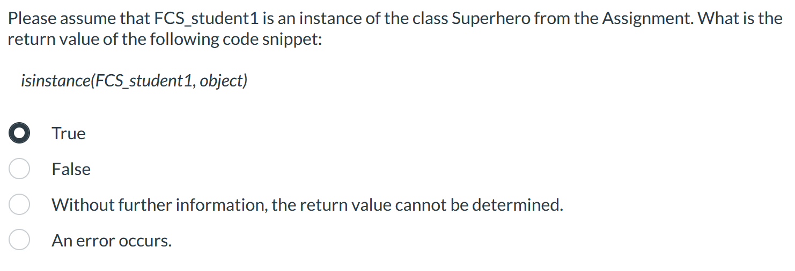
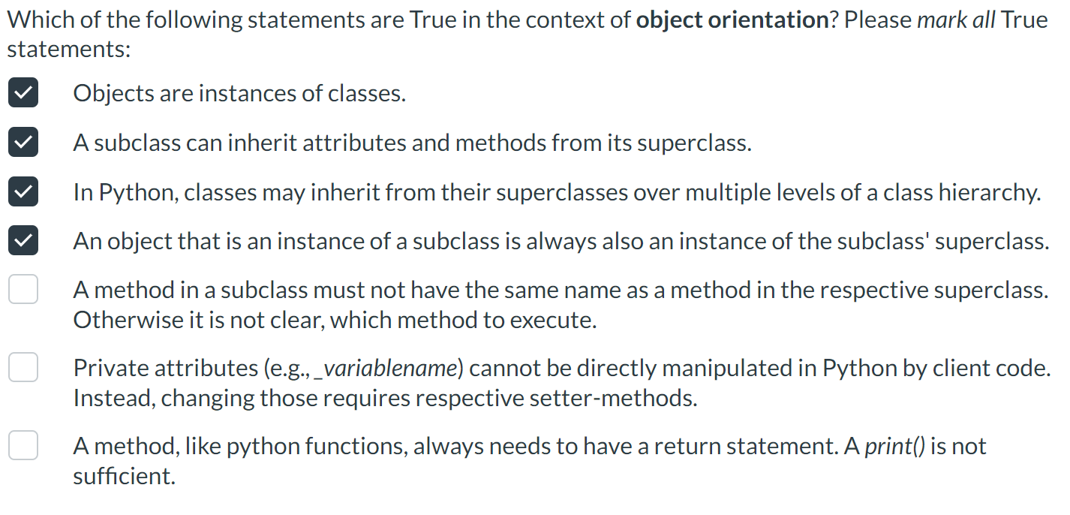
Object Inheritance 1
→ Per definition
→ Per definition
→ Per induction*
→ Per definition
→ Methods can be adapted (overwritten) for subclasses!
→ Protected vs. Private. Access possible (see W5)
→ always has a return value (implicit return statement) – arguable

Slide 9
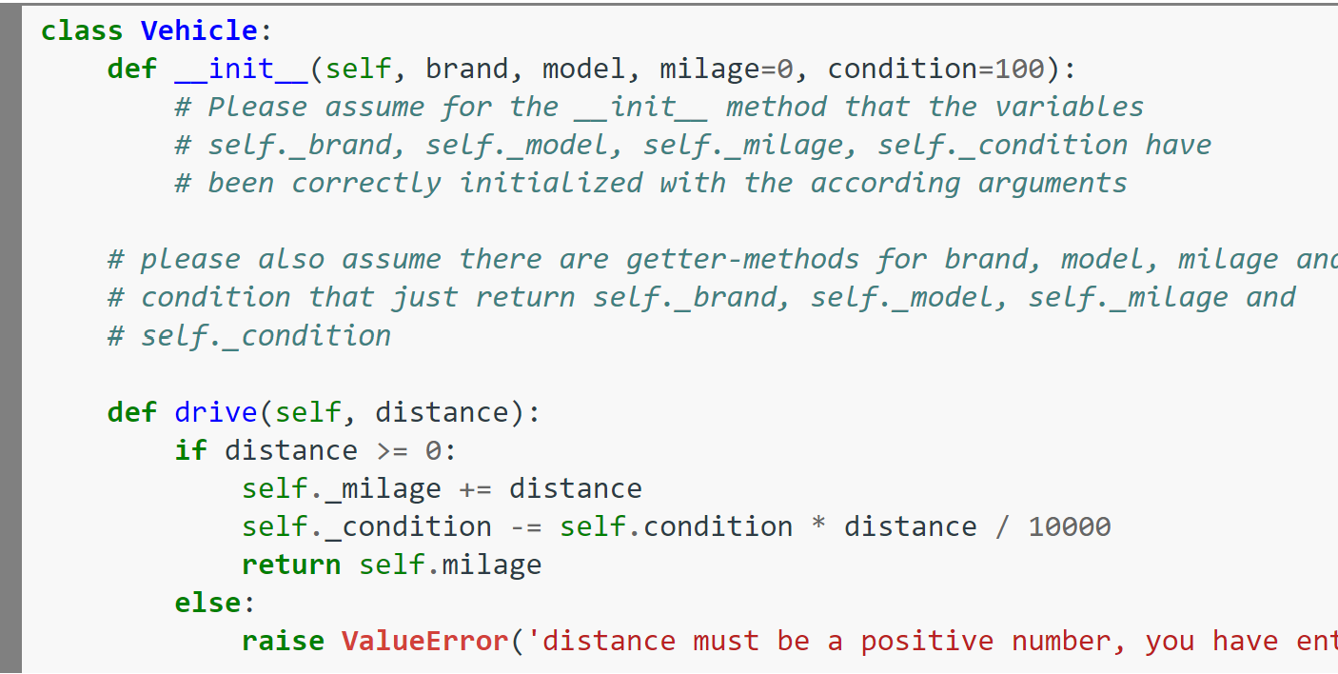
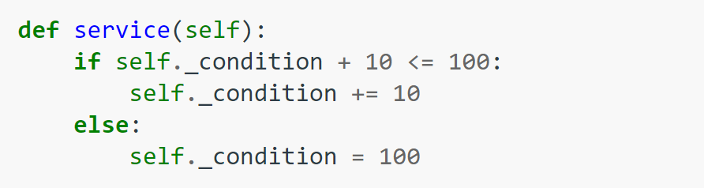
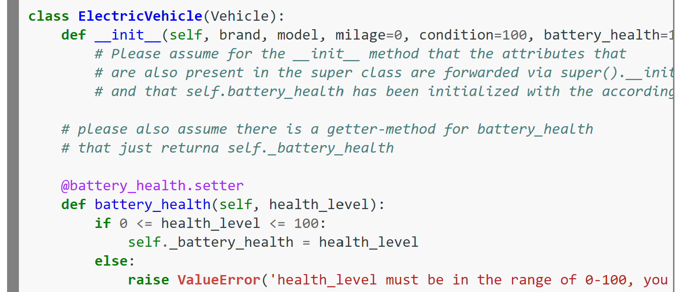
Object Inheritance 2
Clue #1
Clue #2
Clue #3
Clue #4
Clue #5 & #6
Clue #8
Clue #7

Slide 10
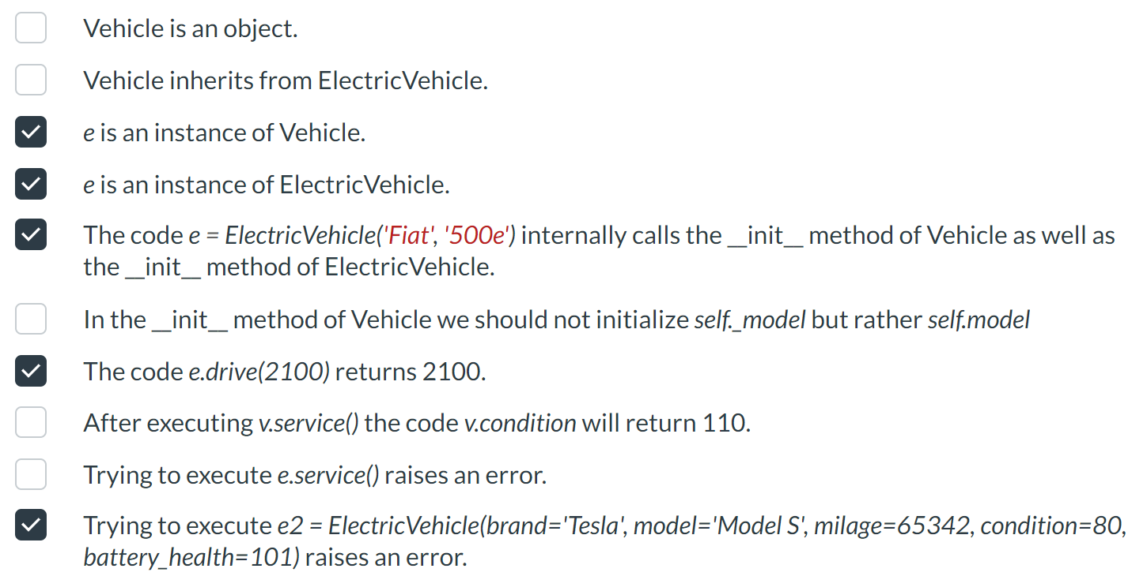
Object Inheritance 2
→ Is a class
→ The other way around
→ Per definition
→ Per definition
→ Correct - we call the super().__init__ method here as well (Clue #6)
→ Clue #2
→Clue #3
→Clue #8
→Clue #4
→Clue #7

Slide 11
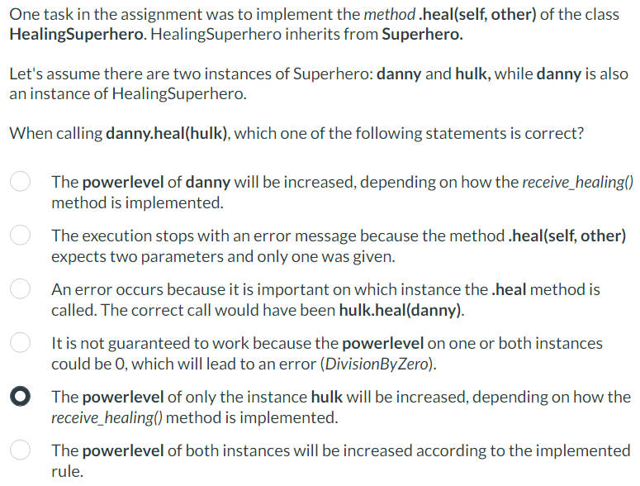
Question about the assignment

Slide 12
Brief summary of last week’s content

Slide 13

GitHub: What is it?
GitHub is an environment where coders can colaborate
together using «GitHub Repositiories»
These repositories allow coders to access and change code files, ensuring that the code files are always up-to-date and bypassing the need of sending files to one another.
Setting up a GitHub repository for your group project is optional, however, we encourage people to try it out due to its benefits.

Slide 14
GitHub Video Series
So what can I do to get into this?
Watch our video-series!
Video 1.1: Installing, Set-up and connecting a repository to Streamlit → Necessary
Video 1.2: Modifying files and resolving merge conflicts →Necessary
Video 1.3: Creating and managing code branches → Optional for learning best practices
After Video 1.1 & 1.2 you should have all the skills you need in order to work together!
For any questions, Google for a solution, e-mail us for help or go to the Monday Coaching sessions.

Slide 15
Brief summary of last week’s content

Slide 16
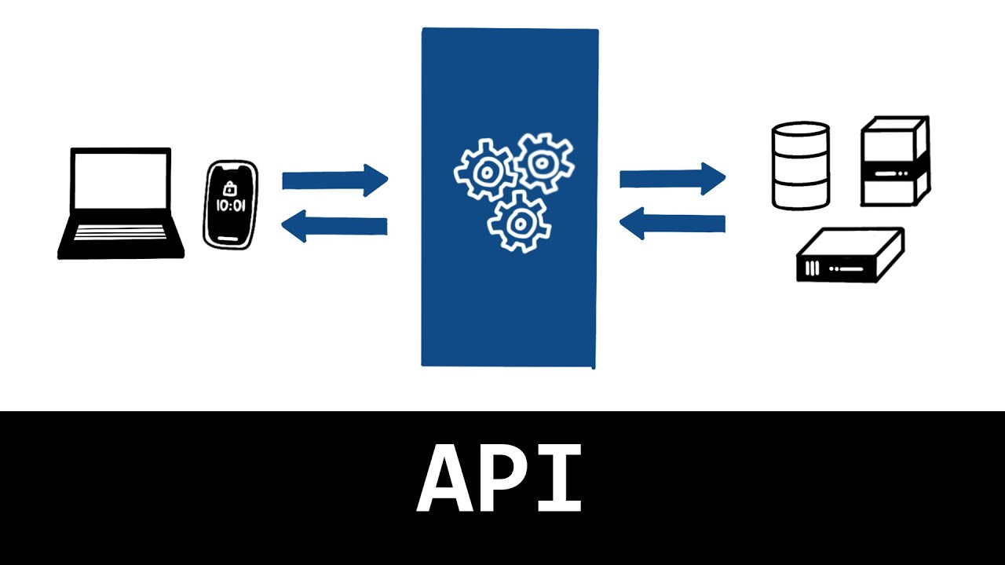
Computer Networks & Distributed Systems
Many different definitions for API exist – don’t learn them by heart
The application is encapsulated and clients access it through controlled interfaces.
The interaction between client and application (on the server) happens through an Application Programming Interface (API).
Therefore Client applications are protected from modifications even when the underlying applications changes (as long as the API remains stable).
clients
applications on the server
It’s the core OOP concepts again – but distributed!

Slide 17
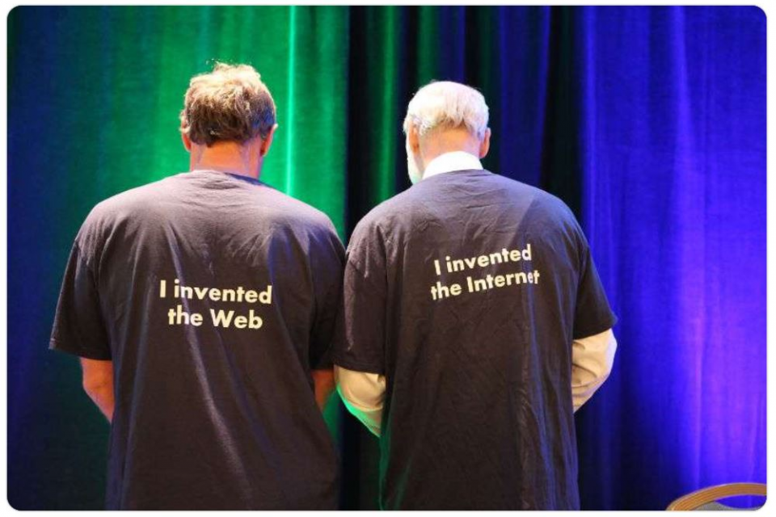
History of the Internet
See Appendix!
The Internet nowadays is a global system of interconnected computer networks that use the Internet protocol suite (TCP/IP) to link billions of devices worldwide.
It was invented for interconnecting networks in the late 1960s (ARPANET). Initially it was used for scientific purposes and the military, but its biggest push was the Web in the early 1990s.
The Internet is not the same thing as the Web.

Slide 18
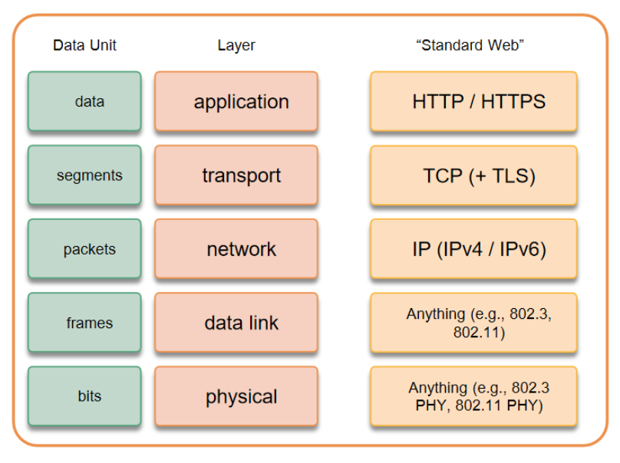
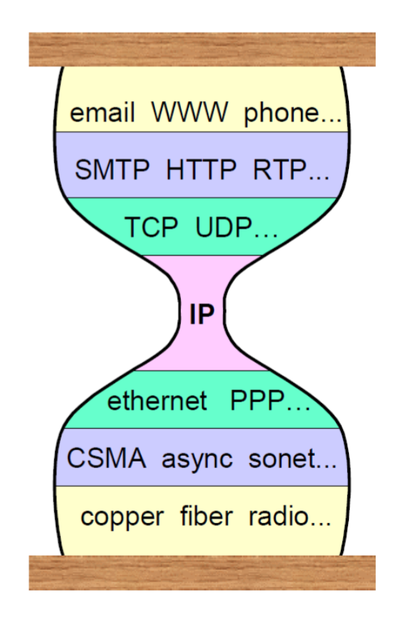
Layering: Separation of Concerns & Networking Stack
See Appendix!
Networking Stack + Standard Web Specifications: «Separation of Concerns» allows:
easier creation of end-to-end solutions
reusable / replacable parts of solutions
but it gets difficult to replace «things»:

Slide 19
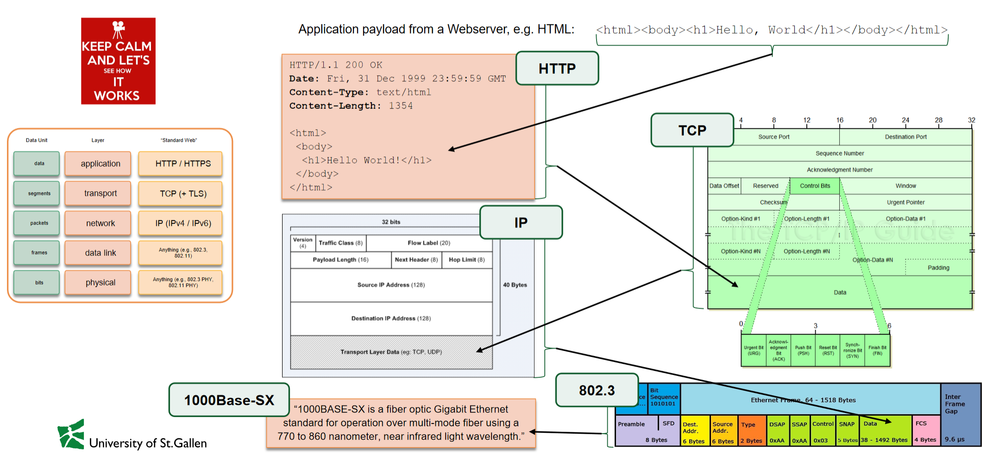
Networking Stack: HTTP example
Keep this in mind for Wireshark!

Slide 20
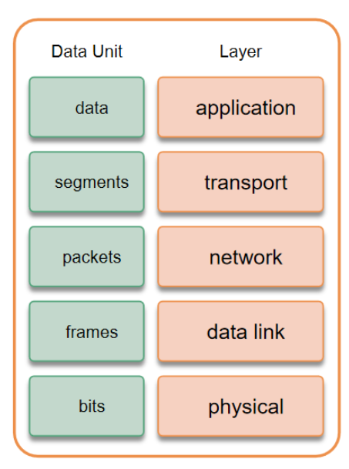
Introduction into Security Transport Layer Security
See Appendix!
TLS is a cryptographic protocol for data privacy & integrity and authentication.
It works by exchanging public keys, from which it is computationally hard to derive the private keys, during the initial setup phase («TLS Handshake»).
TLS runs “on top of” a reliable transport protocol (e.g. TCP). HTTPS (“HTTP-over-TLS) is therefore security on the transport layer (nothing at or below the the transport layer is encrypted).
HTTPS is security on the transport layer. The request above transport is encrypted, but nothing at or below the transport layer. Otherwise the protocol wouldn’t know where to send the data to.

Slide 21
Brief summary of skills necessary to solve Assignment 6

Slide 22
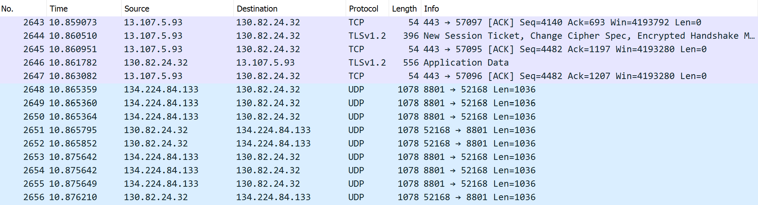
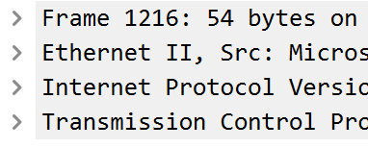
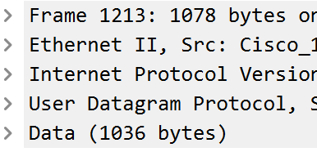
Wireshark
Typically your IP will start with 192.168 (here university wifi)
Am I sending or receiving data?
Which program uses this data?
Bonus Question: Which one is TCP / UDP?
What form of data (zoom or websites?)

Slide 23
Wireshark
Bonus Question: Which one is TCP / UDP?
We can see what protocol has been used. We also know that Port 443 is HTTPS → TCP. We do not see data there, because it is encrypted with TLS.
Am I sending or receiving data?
When the source equals my IP address (or typically 192.168...), I am sending data. When the destination equals my IP address, I am receiving data.
The protocol TLS is an indication for encrypted data. The protocol TCP is a reliable connection and usually indicates interaction with a website. The protocol UDP is an unreliable connection and usually indicates interaction with a datastream (e.g., watching videos, zoom conferences, ...).
One thing that we can usually see in the information are port numbers in the order source → destination. E.g. 8801→52168 (from source to my IP address) and in reverse from my IP address to the source indicates that one of my programs uses the port 52168 and the program on the external machine uses 8801 (which can be verified as Zoom).
What form of data (zoom or websites?)
Which program uses this data?
In the example we have: consuming streamed data, sending streamed data, receiving data from an encrypted website = the HTTP messages are hidden (remember TLS and Port 443 = HTTPS / 80 = HTTP).
In the whole dump (but not in the extract on the slides) we also have: sending data to an encrypted website and DNS messages to resolve the website address to an IP address.

Slide 24
Python Library: requests 1/2
requests
.json method
Interact with web services & APIs by sending HTTP requests…
import requests
url = "https://httpbin.org/get"
r = requests.get(url)
…and receiving HTTP responses:
print(r) > <Response [200]>
print(r.status_code) > 200
print(r.raw) > <urllib3.response.HTTPRes…
print(r.text) > {"args": {}, "headers": {"Acc…
print(r.content) > b'{\n "args": {}, \n "header…
All of these methods have a use-case, however for us they are not all equally easy to read and understand.
A common response format for data is JSON, which is easy for humans & machines to read and write.
To properly work with such data we need to parse it into a suitable python data structure – a dictionary.
content = r.json()
Remember that you can access elements in a dictionary with their key. E.g. you can access the url with the key 'url' or the header host with the nested keys 'headers’ & 'Host'.
content['url’] > 'https://httpbin.org/get’
content['headers']['Host’] > 'httpbin.org'

Slide 25
Python Library: requests 2/2
Parameters
Headers
You can send parameters in an HTTP request. The name of the variables link or parameters does not matter, but the types, keys in parameters and in the function the parameter params do.
link = "https://httpbin.org/get"
parameters = {"user": "uname", "pw": "Test"}
r = requests.get(link, params=parameters)
If you inspect the response, you can see, that the link you sent your request to has been modified by the library:
content = r.json()
content['url']
The url now includes a ? together with your key=value pairs and separated by &:
> 'https://httpbin.org/get?user=uname&pw=Test'
You can also define headers in an HTTP request. Usually done by the requests library this is important for authorization where you modify part of the headers the requests functions send. link = "https://httpbin.org/bearer"
bearer_key = {"Authorization": "Bearer 123"}
r = requests.get(link, headers=bearer_key)
If you inspect the response, you can see, that it worked:
content = r.json()
content
> {'authenticated': True, 'token': '123’}
Again the variable names do not matter but the rest does.
Note that the value in the bearer_key dictionary consists of "Bearer " + "key".

Slide 26
Primer on Assignment 6
Long code, but not complicated
Using an API
class Connection:
# New object with dest. latitude [float], dest. longitude [float], departure [datetime as string], arrival [datetime as string], transport means [list of strings]
def __init__(self, destination_x, destination_y, departure, arrival, transport_means):
# Returns transport means/departure/arrival
def __str__(self):
# Returns departure time as Unix timestamp
def get_unix_departure_time(self):
# Returns arrival time as Unix timestamp
def get_unix_arrival_time(self):
Make an HTTP request and get a JSON response.
Make sure to use the right URL and method.
Use dictionaries with all params/headers in the task – look up the correct keys in the documentation.
Convert the JSON response to a dictionary.
Search your desired object and corresponding values.
Use dictionary keys and/or list indeces to get the desired object (e.g. first connection in Train API).
Use dictionary keys and/or list indeces to get all values (within the desired object).
Hint: Use the Connection class and its attributes!

Slide 27
Exercise 6:
Let’s solve the exercise together…
…to enable you to solve the assignment on your own!

Slide 28
Now you have everything you need to start with Assignment 6

Slide 29
Appendix

Slide 30
History of the Internet
Protocols are at the foundation of (human) communication. Telephones or text messages were new conduits for person-to-person communcation. With the Internet computers became communication endpoints.
The Internet nowadays is a global system of interconnected computer networks that use the Internet protocol suite (TCP/IP) to link billions of devices worldwide. It was invented for interconnecting networks in the late 1960s (ARPANET) and focused on protocols and not on networks. Over time other protocols faded away in favor of TCP/IP’s packet switching. Initially used for scientific purposes and the military, its biggest push was the Web in the early 1990s.
In contrast to Circuit Switching (traditional phone calls; continuous talking), Packet Switching enables non continuous & burst talking, which can be seen as an “evolution of mail” (independently send packets = robust).
IP [Internet Protocol]: Who to talk to / How to get there; TCP [Transmission Control Protocol]: How to talk / How to manage an exchange → Both are based on Packet Switching

Slide 31
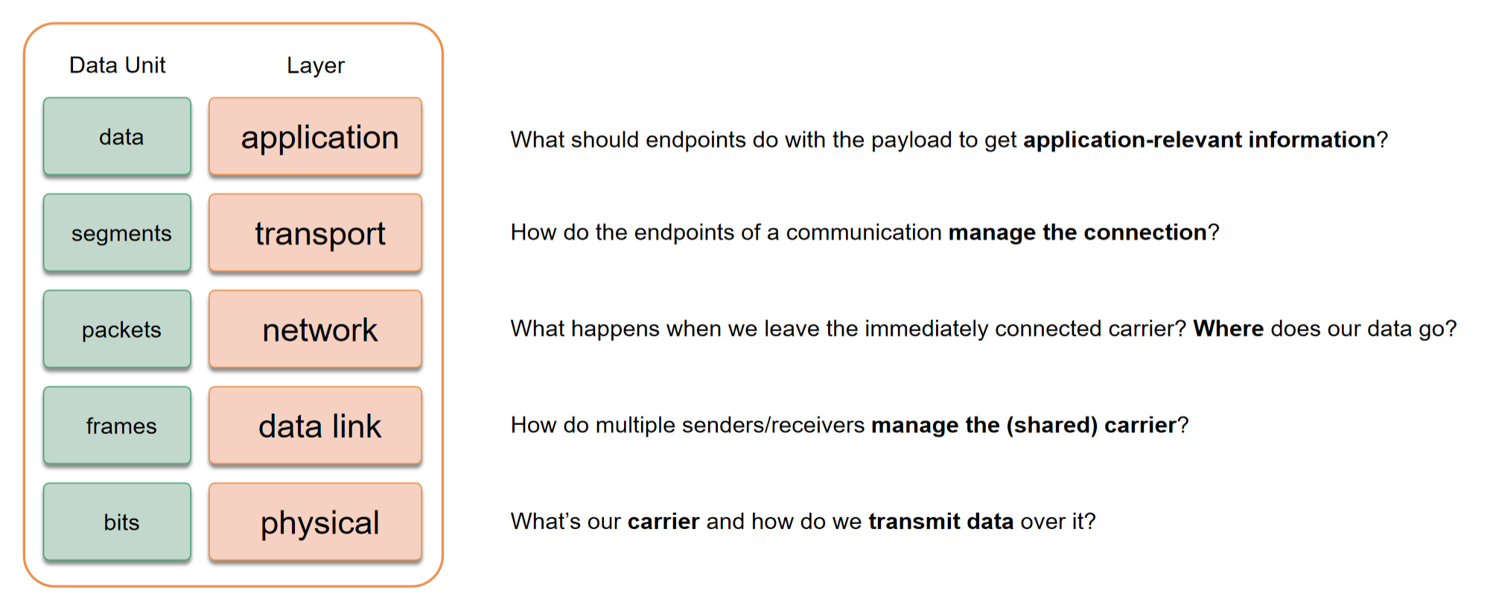
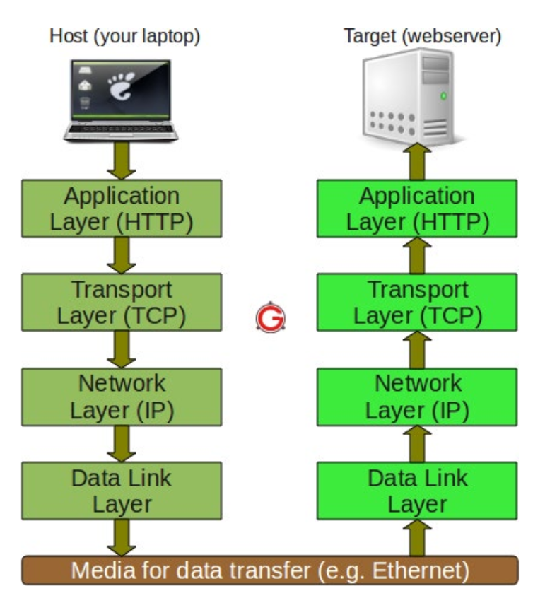
Layering: Separation of Concerns & Networking Stack
but it gets difficult to replace «things»:
«Separation of Concerns» allows:
easier creation of end-to-end solutions
reusable / replacable parts of solutions
Networking stack:

Slide 32
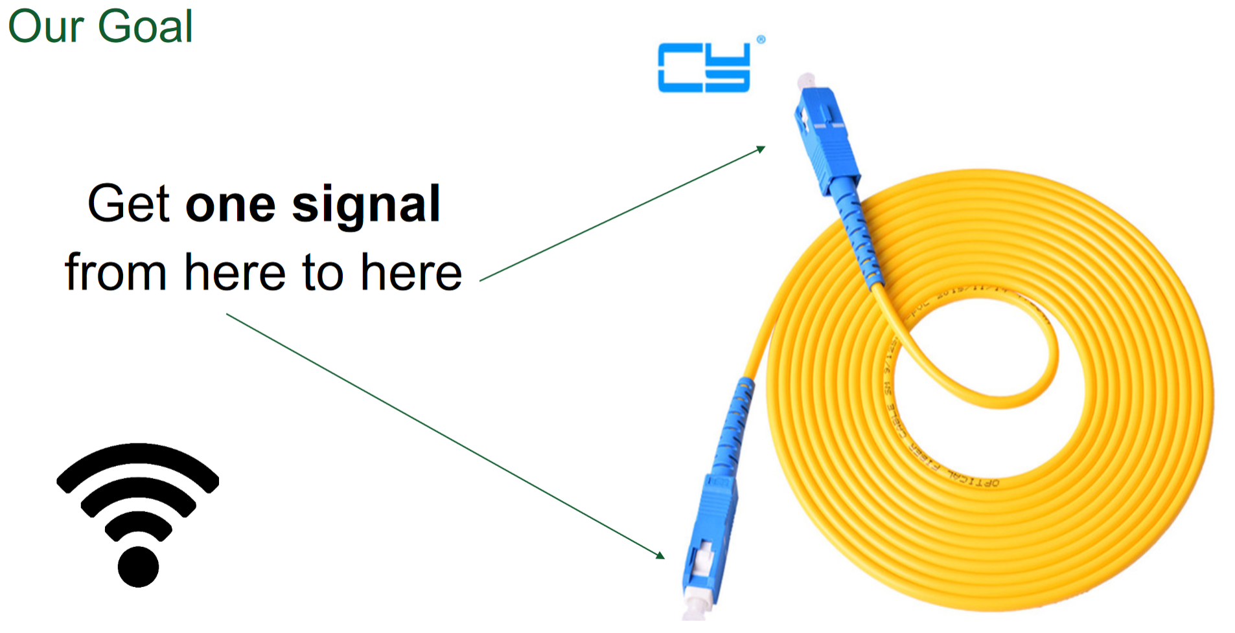
1) Physical Layer
Ethernet Cables
High Voltage
Low Voltage
Fibre Optics
Light
No Light
Wireless Transmission
High Frequency
Low Frequency
There are different way to «encode» 0 & 1 in order to transmit data.

Slide 33
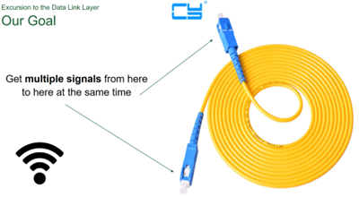

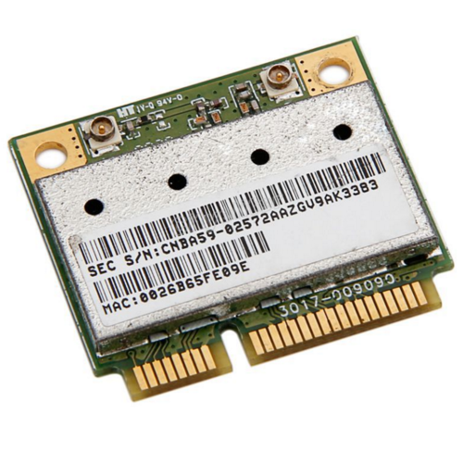


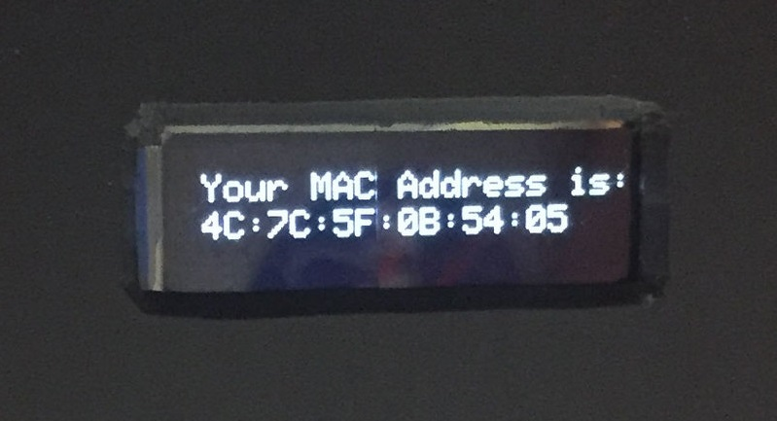
2) Data Link Layer
Get multiple signals from here to here at the same time
MAC addresses are statically (to device network interfaces) assigned unique identifiers → «Burned-in Addresses»
MAC addresses are «burned-in» and do not change.

Slide 34
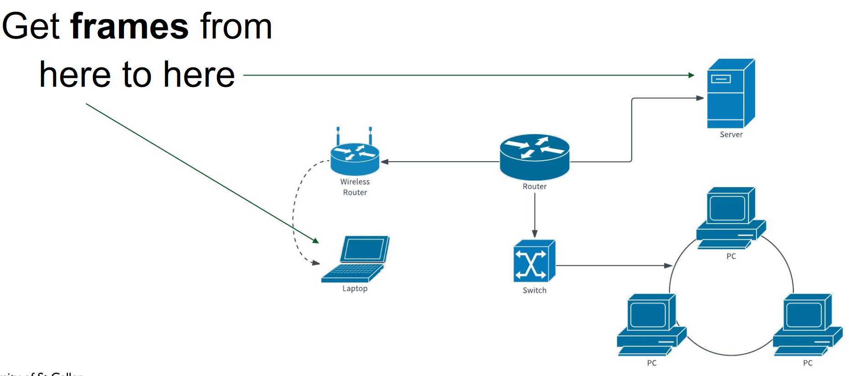
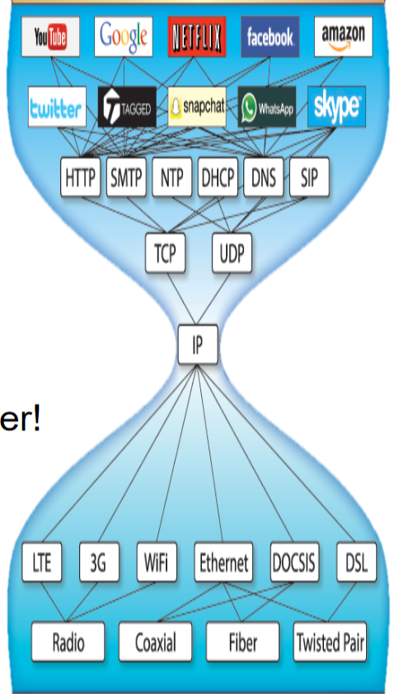
3) Network Layer
IP routing enables internetworking and establishes the internet.
To establish connectivity on a machine-to-machine level, IP Addresses are dynamically assigned to connected devices → «Not burned-in»
Remember bits:
32-bit IPv4 Addresses → 2^32 possibilities - 192.168.0.1 Top-level exhaustion happened on 31. January 2011
128-bit IPv6 Addresses → 2^128 possibilities allow us to address all atoms in the known universe - 2001:0db8:ac10:fe01:0000:0000:0000:0000 At presence about 50% penetration of networking
narrow waist
The routing of IP packets to their destination is solely based on the IP address of the destination.
Allows addressing at the network level
Allows packet routing across networks
«IP over everything, everything over IP» is the biggest network effect ever: It interconnects heterogeneous systems through a global adressing scheme. Drawback: Adding functionality in this layer is extremly difficult (see switching from IPv4 to IPv6)
IP Adresses are dynamically assigned to connected devices and do change.

Slide 35
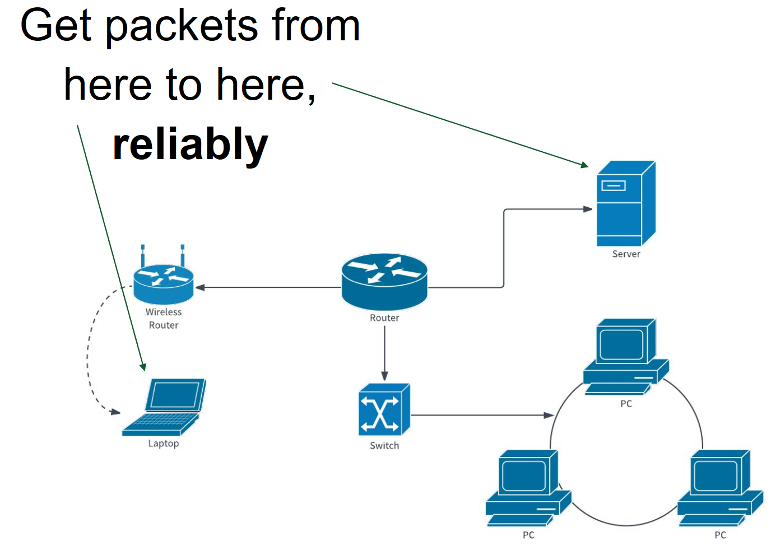
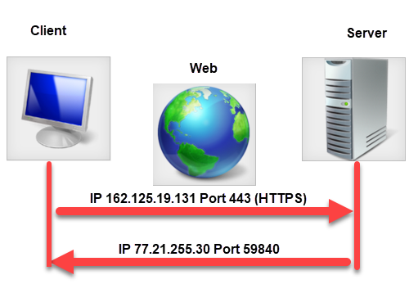
4) Transport Layer
To establish connectivity between processes, TCP or UDP
use Ports, which identify different processes on the machine.
TCP – for loss-intolerant settings e.g. HTML (websites):
more reliable connections (no data lost or duplicated) through serial numbers in data packets and flow-control
more overhead
UDP – for loss-tolerant settings e.g. video calls:
unreliable connections that just sends data without setup phase, serial numbers or acknowledgements
less overhead
Remember Ports:
80 requests to HTTP
443 requests to HTTPS
TCP is used when losing a single packet renders all the data useless (e.g. HTML for a website). UDP is used when losing a single packet is not that bad (e.g. «bad connection» in a video call). Both use Ports.

Slide 36
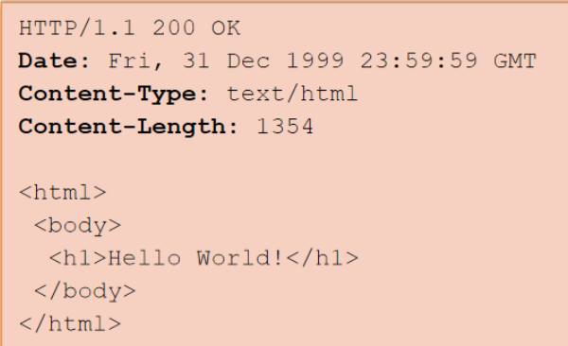
5) Application Layer
DNS
HTTP
Reorganizing a network may change all IP addresses. Important hosts should therefore not be identified address-based.
A name is an abstract identification and more stable than IP addresses, e.g. www.google.ch.
To use a named service, we need a mapping. The Domain Name System (DNS) provides this service.
HTTP is a text-based protocol used to transmit text messages containing encoded entities. HTTP messages are human-readable (not all entities) & need a reliable connection → builds on top of TCP.
Clients send a request to a resource (identified by URI, e.g. www.google.ch) with an HTTP method (operation to apply, e.g. GET, POST, PUT, DELETE) & info about the request (header). The resource sends back a response with a status code (different codes), the «answer» & infor about the response (header).
Applications are built on top of the layered networking stack. They communicate with each other through application-layer protocols

Slide 37
Networking Stack: Everything playing together (HTTP example)

Slide 38
Networking Stack: Case study Internet
Internet is a network of networks that all use the Internet Protocol:
IP provides addresses for Internet hosts (narrow waist of the stack).
TCP is used for reliable, in-order communication and flow control on top of IP. (UDP for unreliable best-effort, also builds on IP.)
DNS assigns stable (host)names to IP addresses.
The Web is one of the main applications of the Internet (not to be confused with eachother). The main protocol of the Web is HTTP(S).
World Wide Web (WWW) is an information system where resources are identified by URIs (Uniform Resource Identifiers), which are accessible over the Internet. It’s main application-layer protocol is HTTP.

Slide 39
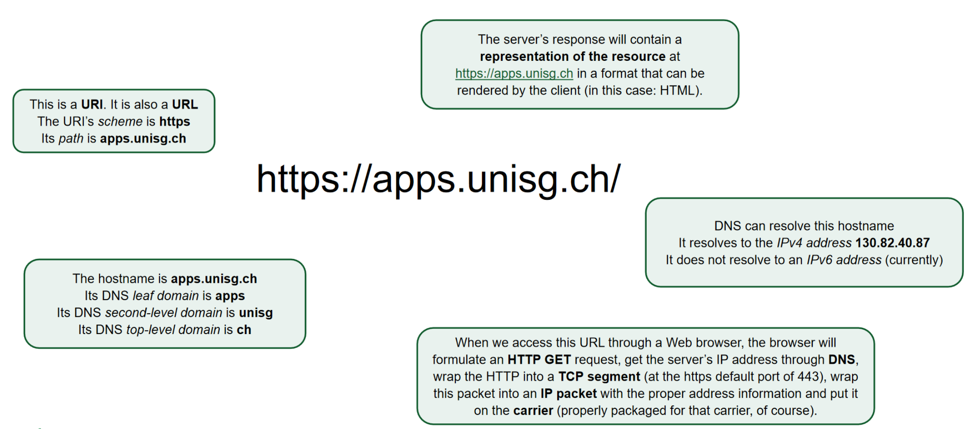
Networking Stack: Case study Internet

Slide 40
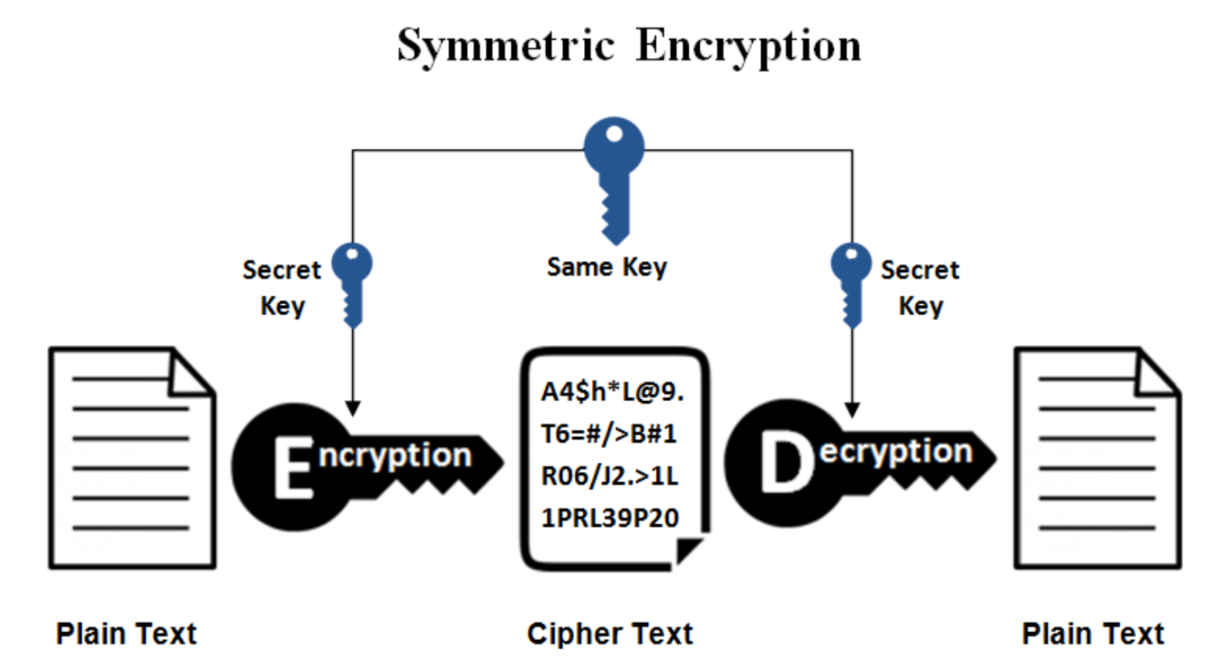
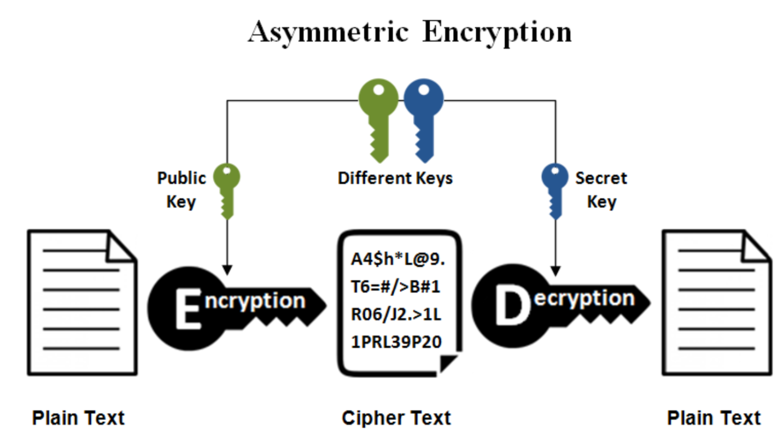
Introduction into Security: Encryption Methods
Symmetric Encryption
Asymmetric Encryption
Fast & Simple but requires a shared key [well-known algorithms include AES, DES].
No shared key but slow [RSA, DSA, (1-way) Hash Functions]; public key is authenticity [=certificates].
It would be great to use a «slow» method to derive a shared secret and then use this shared secret for «fast symmetric encryption». One «slow» method is called «Diffie-Hellman Key Exchange».

Slide 41
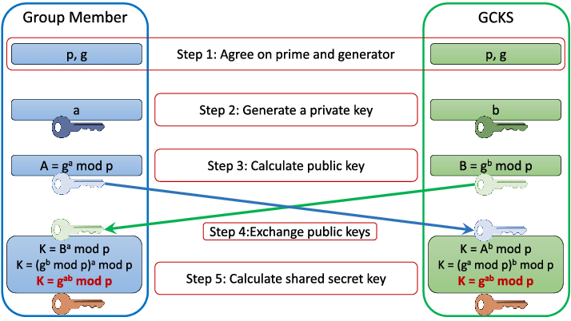
Introduction into Security: Diffie-Hellman Key Exchange
You only need to understand that a shared secret key (K) is generated by exchanging public keys (A, B) [no private keys (a, b)] and that it works because it is computationally hard to derive a from only p, g & A.

Slide 42
Introduction into Security: Transport Layer Security
TLS is a cryptographic protocol for data privacy & integrity and authentication.
Each entity has a private and a public key (which are mathematically coupled). At the start of each session («TLS Handshake») encryption algorithms & a shared secret are negotiated (public keys advertised, private keys kept private). Encryption keys are generated from the shared secret and used for symmetric encryption of the transmitted data or authentication:
encrypted with other’s [receiver’s] public key, decrypted with own [receiver’s] private key
signed with own private key and advertising public key, authenticated through these two
TLS runs “on top of” a reliable transport protocol (e.g. TCP). HTTPS (“HTTP-over-TLS) is therefore security on the transport layer. The entire request above transport is encrypted, but nothing at or below the transport layer.
HTTPS is security on the transport layer. The request above transport is encrypted, but nothing at o below the transport layer. Otherwise the protocol wouldn’t know where to send the data to.

Slide 43
<Your Name>
<Function>
lirst.last@<student.>unisg.ch

